Slide 1

Adidas Sales Performance Dashboard
Strategic Analysis of Retailer, Regional, and Product Trends
Prepared by - Tadishetty Sriram

Slide 2
High-Level Sales & Profit KPIs
Our performance metrics reveal strong demand across all channels, with operating margins demonstrating resilience and efficiency in our primary sales networks.
£2.4B
£487M
8.2M
20.3%
Total Revenue
Operating Profit
Units Sold
Operating Margin
Year-to-date sales performance
Strong profitability maintained
Volume growth across categories
Healthy margin performance
Overall performance indicates strong demand, with operating margins remaining healthy across primary sales channels, positioning Adidas favourably for continued growth.

Slide 3

Geographic Performance Analysis
Regional Sales Distribution
The Northeast and West regions are driving the majority of volume, identifying key markets for inventory prioritisation and strategic resource allocation.
Top Performing Regions:
Northeast: 38% of total sales volume
West: 31% of total sales volume
South: 22% of total sales volume
State-level analysis reveals concentrated demand in New York, California, and Texas, representing critical distribution hubs for our retail network.

Slide 4

Category Performance: Men vs. Women
Street Footwear for Men is a leading revenue driver, whilst Women's Apparel shows significant potential for margin growth through strategic merchandising initiatives.
Men's Footwear
£842M Revenue
Street Footwear: Top performer
Athletic Footwear: Strong growth
Premium segment expanding
Women's Footwear
£564M Revenue
Athletic category leading
Lifestyle segment emerging
Innovation opportunities

Slide 5
Category Performance: Men vs. Women ( Apparel)
Street Footwear for Men is a leading revenue driver, whilst Women's Apparel shows significant potential for margin growth through strategic merchandising initiatives.
Men's Apparel
£521M Revenue
Performance wear dominant
Casual range growing
Seasonal consistency
Women's Apparel
£473M Revenue
Highest margin potential
Athleisure trend accelerating
Premium tier expansion

Slide 6
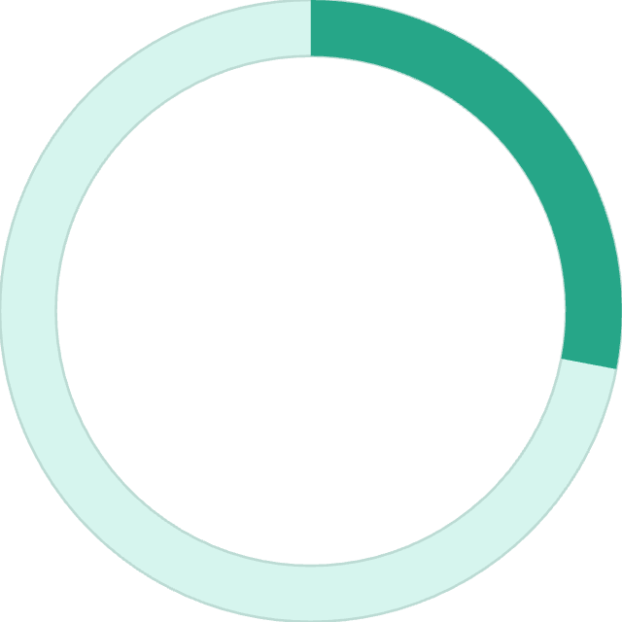
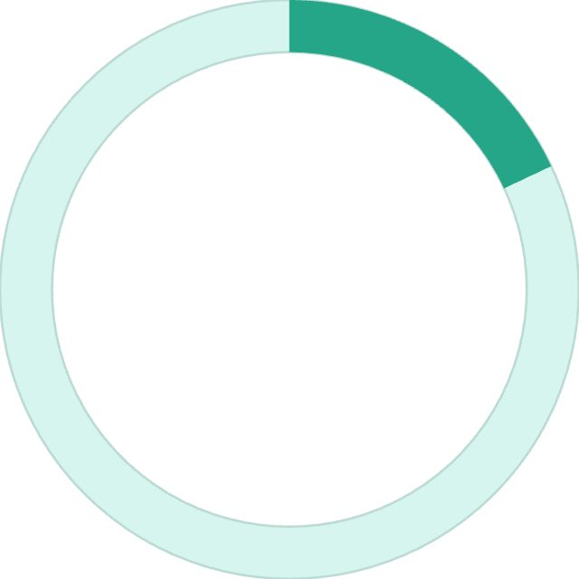
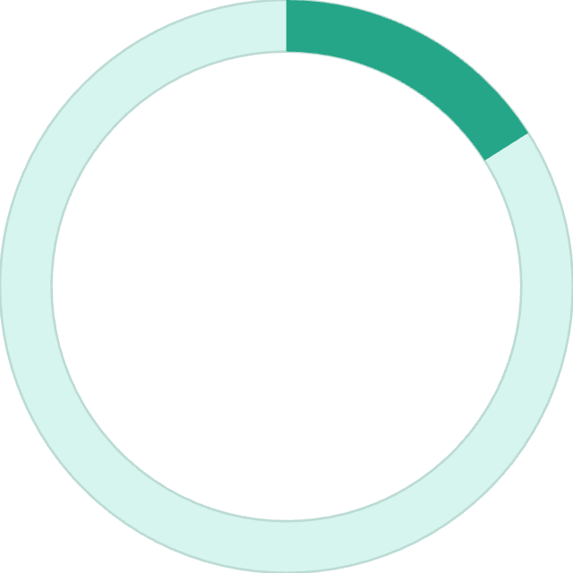

Channel Profitability Analysis
Sales Performance by Method: Online vs. Outlet vs. In-Store
28%
18%
16%
Online Margin
In-Store Margin
Outlet Margin
Highest profitability channel
Traditional retail performance
Volume-driven efficiency
Online sales deliver the highest operating margins due to lower overhead costs, suggesting a strategic pivot towards enhanced digital marketing and e-commerce infrastructure investment.
Key Channel Insights: Digital platforms demonstrate superior margin performance whilst maintaining customer satisfaction. In-store channels provide essential brand experience, whilst outlets serve clearance and volume objectives effectively.

Slide 7




Strategic Recommendations
Future Growth Opportunities & Action Plan
Optimise Inventory Allocation
Increase Street Footwear stock levels in high-performing Northeast states, particularly New York and Massachusetts, to capitalise on concentrated demand patterns and reduce stockout incidents.
Accelerate Digital Investment
Boost digital advertising spend by 35% to capitalise on high-margin online sales channels. Focus on targeted campaigns for premium product lines and emerging categories.
Regional Performance Enhancement
Review underperforming retailers in the South region for potential optimisation. Implement performance improvement programmes or consider strategic partnership restructuring.

